Slide 1

IBM HR Data Analysis
INFO 5602 - Information Visualization
Presented By
Shreyash Sahare

Slide 2

Agenda
3 | Context
4 | Motivation
5 | Data Source
6 | Tools Used
7 | Research Questions
8 | A Glimpse of the Dashboard
9 | Answers to the Research Questions
10 | Link to the Dashboard

Slide 3
Context
The role of the HR (Human Resources) department in every company has gained utmost importance in today’s dynamic business landscape.
Attrition rates are a significant concern for IBM especially in the last few years, affecting career development opportunities and several other underlying organizational issues.
The primary objective of our HR data analysis is to delve into the factors influencing attrition at IBM and uncover actionable insights for talent retention.

Slide 4



Motivation
Enhancing Talent Retention
Fostering Employee Engagement
Driving Organizational Performance
Develop targeted retention strategies to retain the top talent in the industry.
Encourage a culture of employee engagement and satisfaction
Effective workforce planning is essential for the company to have the right talent in the right roles at the right time.

Slide 5
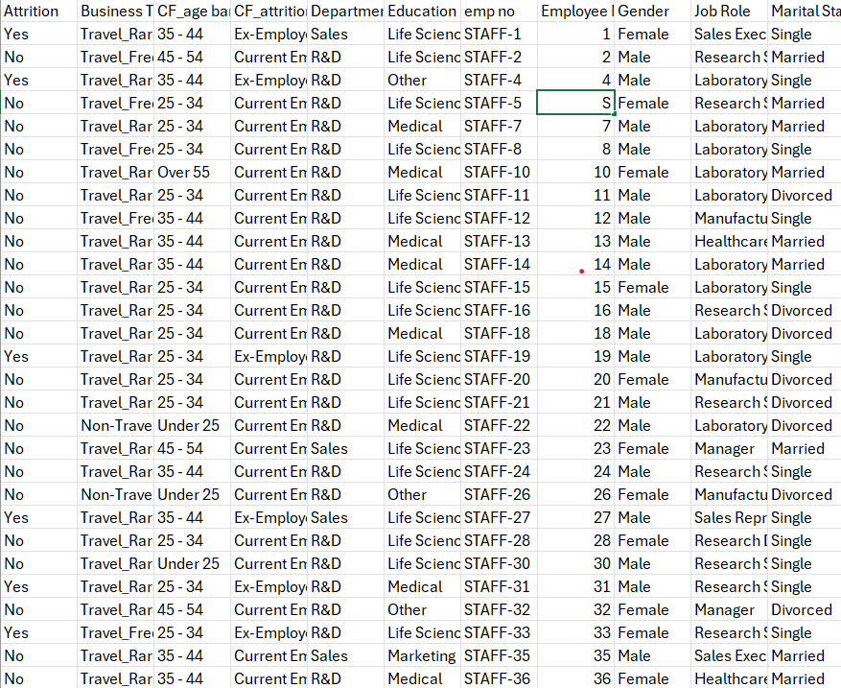
Data Source
This dataset is taken from Kaggle datasets
The dataset has 1470 records
Comprises of 39 features that includes the following:
Attrition
Department
Education
Gender
Job Role
Performance Ratings
Job Satisfaction

Slide 6

Tools Used

Slide 7
Research Questions
How does the attrition rate in sales department vary with the education level?
Is there a link between travel frequency and attrition rate?
Which age group has the highest attrition rate despite having a high job satisfaction?
Which is the safest job role (the one with the lowest attrition rate)?

Slide 8
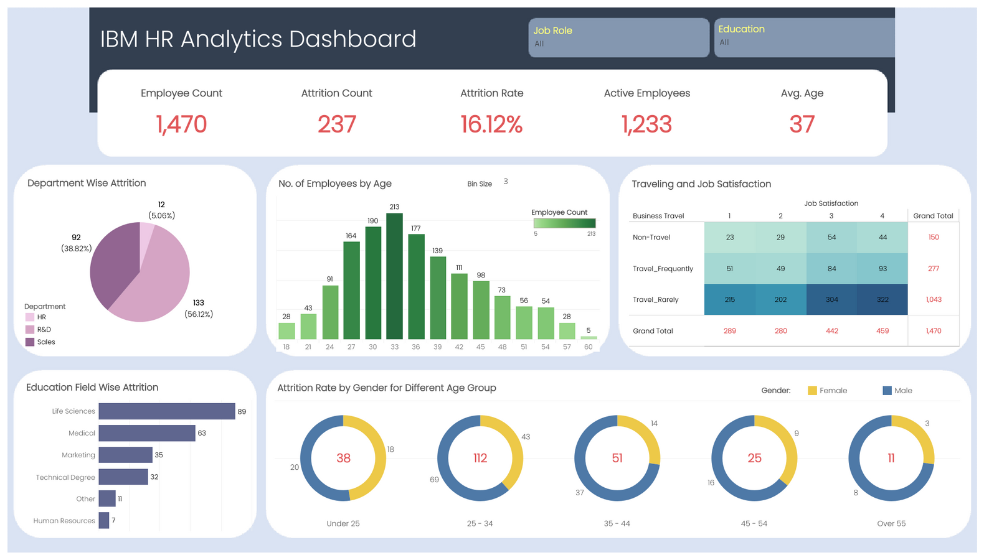
A Glimpse of the Dashboard

Slide 9
Answers to the Research Questions
How does the attrition rate in sales department vary with the education level?
Soln: Highest in Associates Degree, followed by Masters, Bachelors, High School and Doctoral
Is there a link between travel frequency and attrition rate?
Soln: Yes. Employees with the highest travel frequency have the highest attrition rate while the non-travellers have the lowest attrition rate
Which age group has the highest attrition rate despite having a high job satisfaction?
Soln: Ages 25-34
Which is the safest job role (the one with the lowest attrition rate)?
Soln: Research Director

Slide 10
Links and References
URL for Dashboard:
Link
URL for Dataset:
Link

Slide 11

Questions and Discussion

